Slide 1

& Digital Collections
Notes:
This presentation will introduce you to the Creative Commons organisation; the licences; and the way in which application of those licences has facilitated some inspirational examples of sharing in the GLAM sector.
This presentation is based on earlier works by CC staffers who I thank and acknowledge- they are attributed at the end of this presentation.

Slide 2

Notes:
Creative Commons is a global nonprofit organization with staff and affiliates across the world.
CCs mission is to make it easy for individuals and institutions to access, build on, and help grow the public commons of cultural, educational, and scientific works – that has existed for thousands of years.
Locally, the CCau affiliate is made up of
QUT- GLAM sector
AusGOAL- Government
National Copyright Unit- education

Slide 3
A simple, standardized, legally robust way to grant © permissions to cultural works and data
Notes:
CC filled the gap between “all rights reserved” and the public domain. Before CC, a creator could either reserve all rights or give them all way. With CC, a creator can now maintain their copyright, while granting certain reuse permissions to the public.
To facilitate safekeeping and widespread growth of the commons, CC developed a simple, standardized and legally robust set of tools that allows institutions and individuals to grant © permissions to their works. Before CC, there was no standardized way to do this.

Slide 4
CC Licenses
Enable © holders to grant copy and reuse permissions to the public
6 licenses:
Some grant commercial uses
Some grant derivative uses
All require attribution
Notes:
CC provides six copyright licenses, free of charge, for any entity to use.
With all the licences
the owner retains copyright, and
all of our licenses require attribution to the copyright owner.
But some of these licences
grant commercial uses while others reserve commercial uses;
some grant derivative uses while others reserve the right to remix, translate or build upon the material.

Slide 5




4 Elements
Attribution
ShareAlike
NonCommercial
NoDerivatives
Notes:
This is achieved through four elements: Attribution, ShareAlike, Noncommercial, and No derivatives.
All licenses contain the basic element of Attribution, on top of which you can choose to apply one or more of the additional three conditions.
For example:
- If you want to prohibit commercial uses, you would add the non-commercial condition
- If you want to require that downstream users also license their adaptation of your work under the same conditions, you would add the sharealike condition
- If you want your work to be redistributed “as-is” or verbatim, you would add the no derivatives condition

Slide 6
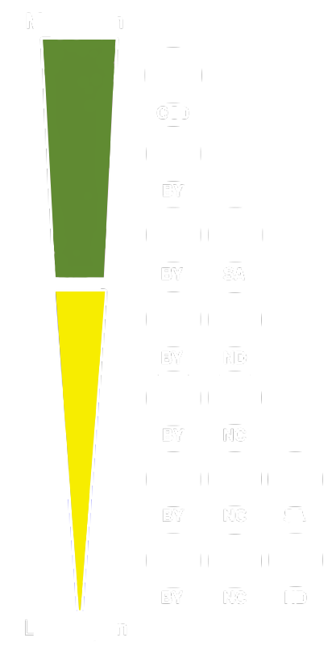

Public Domain Dedication
Licences
Notes:
These four license elements can be combined in six ways, resulting in Six CC licenses.
They are featured here on a spectrum of the most open or permissive license, which is CC Attribution, to the most restrictive license, which is CC Attribution-Noncommercial-NoDerivatives.
In addition to the licenses, CC offers two public domain tool. In terms of “open-ness” at the top is CC0, the public domain dedication tool, which is available to those wishing to waive their copyright in a work. CC0 will figure in the examples of museum uses of CC later.
The “free cultural Works seal” is applied to the Creative Commons licences that qualify as Free Culture Licenses according to the “Definition of Free Cultural” which was coined in the context of Wikimedia development. Public domain is also an acceptable copyright status for free cultural works according to the Definition.
This seal and approval signals an important delineation between less and more restrictive licenses, one that creators and users of content should be aware of
some important projects accept only freely (as defined) licensed or public domain content, in particular Wikipedia and Wikimedia sites, which use the Definition of Free Cultural Works in their licensing guidelines
………………………………………………………………………………………….
A free cultural work must not restrict any particular kind of use-
Freedom to use the work itself
Freedom to use the information in the work for any purpose
Freedom to share copies of the work for any purpose
Freedom to make and share remixes and other derivatives for any purpose
“Cultural works” is simply the term chosen by Freedom Defined to distinguish non-software works that should be under a free content license rather than a free software license.
https://creativecommons.org/freeworks

Slide 7

CC Zero =
I want to waive all of
MY rights to a work.
(legally operable)
Notes:
CC ZERO = you waiving all of YOUR rights so that you have zero rights left in a work.
CC zero is a tool for you to waive all of your copyrights in a work, effectively dedicating it to the public domain. In this sense, CC0 is often called the public domain dedication tool.
CC ZERO Examples of Use
Europeana — Europe’s digital library — releases its metadata into the public domain using CC0.
Figshare- figshare allows researchers to publish all of their research outputs in an easily citable, searchable, shareable manner. Figshare has adopted CC0 as the default tool for researchers to share their datasets.
Open Goldberg Variations- http://www.opengoldbergvariations.org/ - before OGV- public domain recordings of Bach’s Goldberg Variations were hard to find, even though the scores themselves are in the public domain.

Slide 8
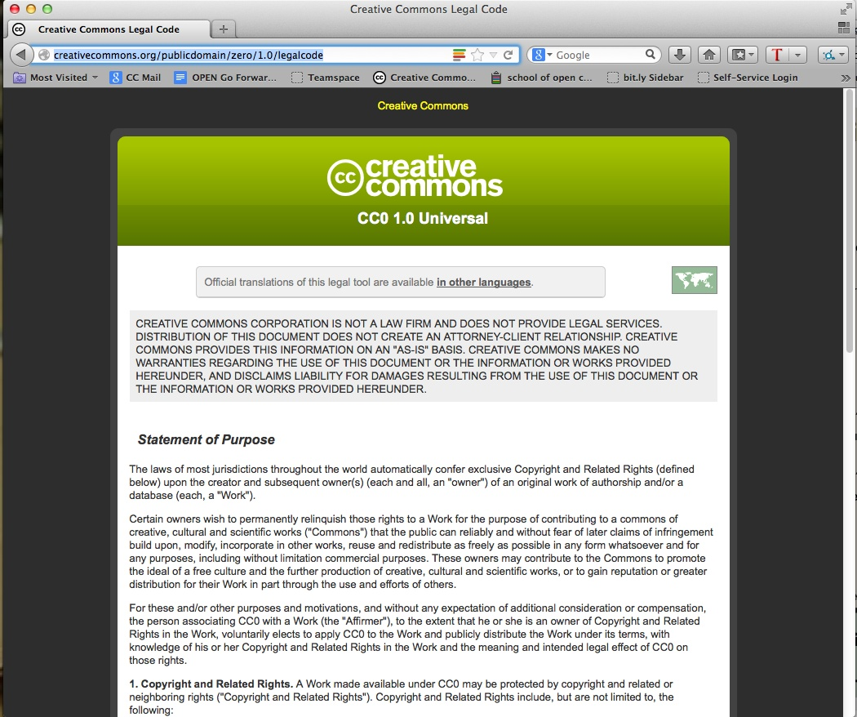
Notes:
CC0 has a legal code beneath it, because it’s a tool for creators to use to relinquish their rights to a work, and you need a legal mechanism to do that.

Slide 9

PD Mark =
For works already in the public domain.
(legally operable)
Notes:
The Public Domain Mark is for marking works that are already in the public domain.
The public domain mark is mainly used by institutions to mark materials archived from hundreds of years ago-
Wikimedia Commons uses the PD mark -Flickr- stops short of the PD mark- “no known copyright restriction”-https://www.flickr.com/commons/usage/
……………………………………………………………………………………………………………………………………………………………….
In the U.S., any work published before January 1, 1923 anywhere in the world^{[1]} is in the public domain.
Other countries are not bound to that 1923 date, though. http://en.wikipedia.org/wiki/Wikipedia:Public_domain
The ACC information sheet “Duration of copyright” includes a very useful “public domain” table”.

Slide 10
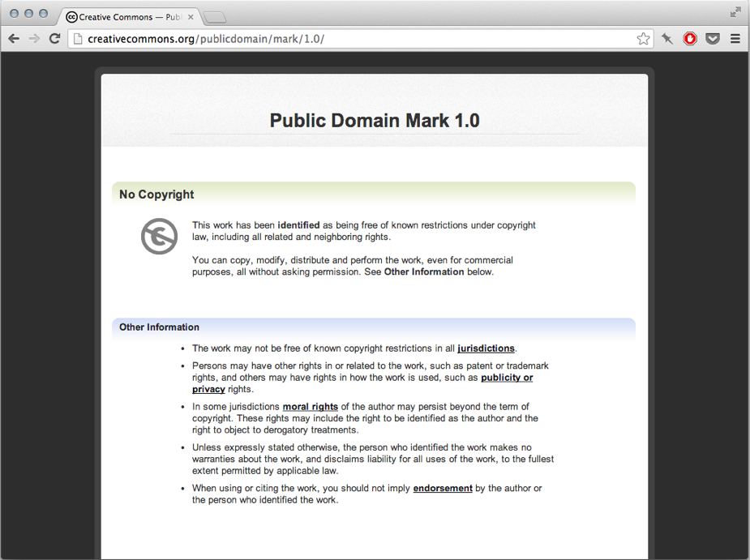
Notes:
This is what the deed for the public domain mark looks like. The language indicates that it is more of a tag or label: “this work has been identified as being free of known copyright restrictions…”
There is no link to a further legal code beneath this summary, because there is none. It’s just a label to make it easier for other people to see that the work is in the public domain.

Slide 11
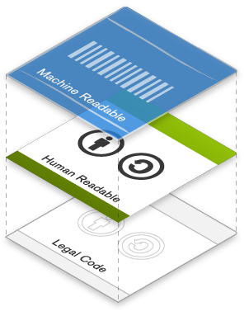
Notes:
All of the legal tools are designed with the web in mind. The licenses have a 3 layer design, which gives three ways to communicate the license: one for legal interpretation, one for plain English, and one for machines.

Slide 12
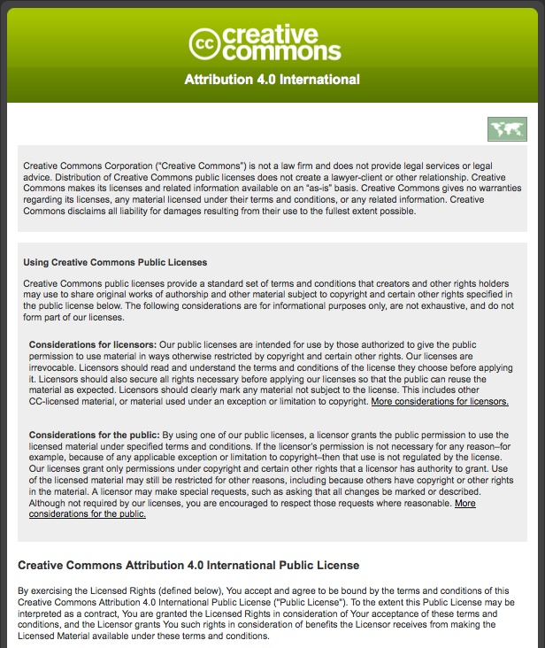
Legal Code
Notes:
So just a quick snapshot of each –
This is the legal code - written by and for lawyers.
It’s the actual license, the document that lawyers drafted so that the license works like it’s supposed to according to domestic and international copyright laws.

Slide 13
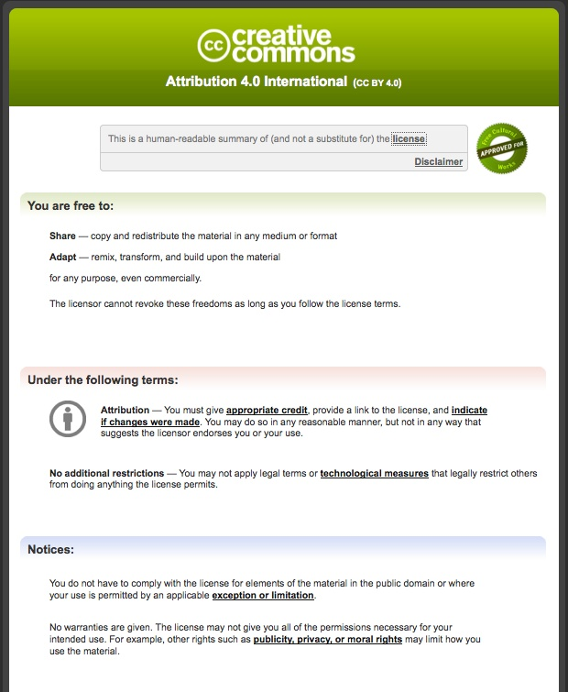
Plain English
Deed
Notes:
This is the “human readable” summary of the license, which sums up the most important terms and conditions of the license in non-technical language.
One way to think of it is as the user-friendly interface to the actual license.

Slide 14
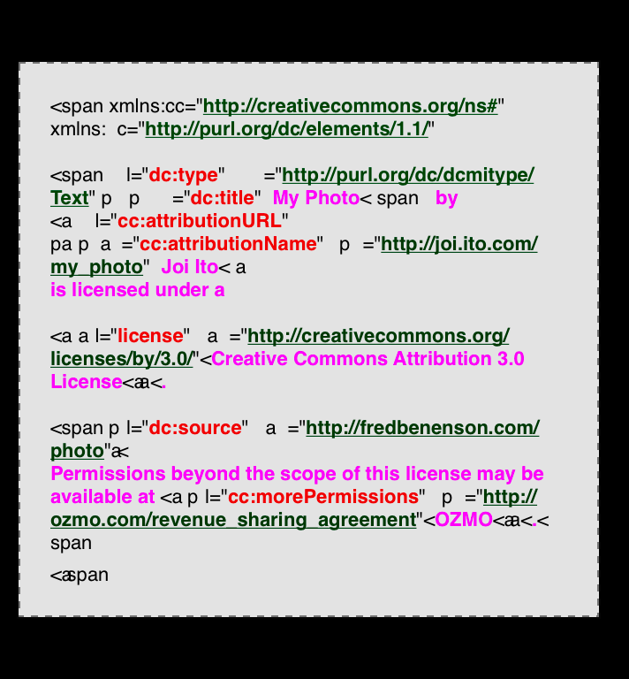
Machine
Readable Metadata
Notes:
This is the machine-readable metadata.
When you mint a licence for online use all you have to do is copy and paste the resulting html it into you your webpage editor. The HTML code summarizes the license and associated metadata (such as author and date) into a format that software, search engines, and other kinds of technology can understand.

Slide 15
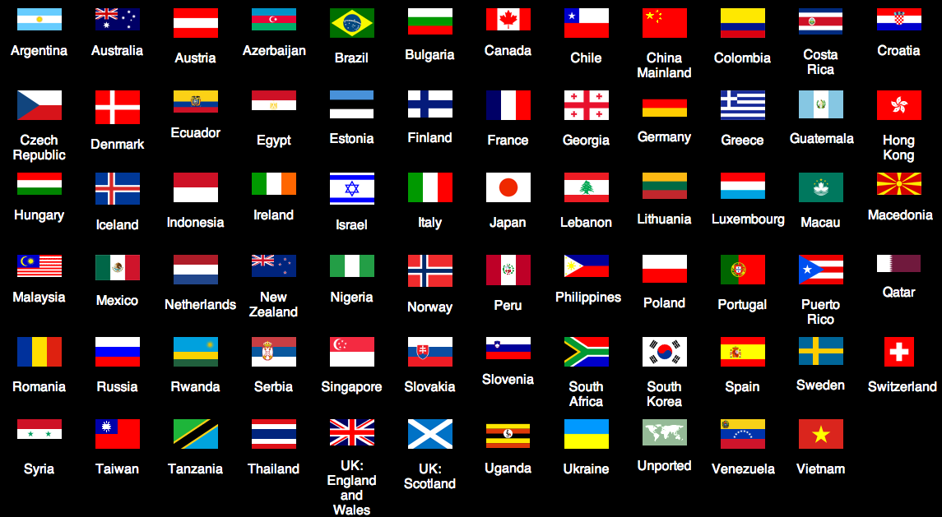
Notes:
The licences are globally operable. Earlier versions of the licences which included jurisdiction specific versions e.g. 3.0 Australia have been updated in V4.0 licences which are regarded as “international” without requiring local versions ie. “porting”.
………………………………………………………………………….
License Versioning history- https://wiki.creativecommons.org/wiki/License_Versions
Retired tools- http://creativecommons.org/retiredlicenses (e.g. sampling)
SA Compatible Process- both earlier SA versions and also non- CC licences e.g. Free Art/ GPL https://wiki.creativecommons.org/wiki/ShareAlike_compatibility

Slide 16
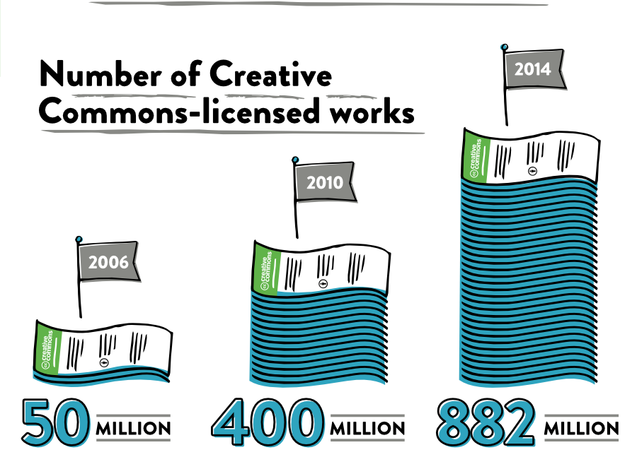
Notes:
For the 2014 State Of The Commons report Google gave us data regarding CC licensed works on the web.
The conservative estimate today is that 882 million works exist under CC licenses or CC0. It’s expected that the number will exceed 1 Billion in 2015.
These works are images, videos, songs, podcasts, government works, educational materials, scientific data, and more.

Slide 17
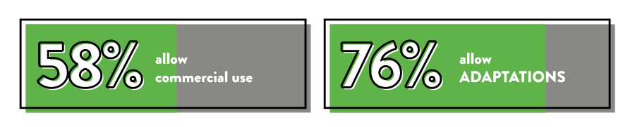
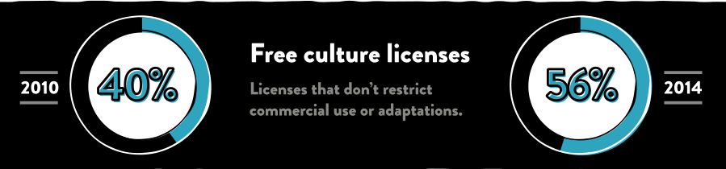
Notes:
There is a clear trend toward open-ness
more creators are allowing adaptations and commercial use than before
Over half are free culture works

Slide 18

CC licenses are robust, built on © law
Clarity and specificity regarding use
Data embedded w/assets; enables browse/search filters
Notes:
These last two slides summarise the value of CC licensing to digital collections…

Slide 19
Digital collections
Notes:
Many millions of these works are works that have been released by cultural heritage institutions. Creating digital collections and facilitating access to those collections through open licensing creates a new dimension to engagement with users and community through
Sharing Digital Collections – whether those collections are made up of Images, Audio, Video – or a mixture of all three
Sharing Collection Records – catalog data about collections
Encouraging reuse and participation around collections.
For information read the 2014 Innovation Study: Challenges and Opportunities for Australia's Galleries, Libraries, Archives and Museums report referenced at the end of the presentation

Slide 20
Engaging
Users +
Community
Sharing
Digital
Collections
Sharing
Collection
Records
Notes:
The following digital collection examples highlight engagement all three of these aspirations…

Slide 21
Rijksmuseum
150,000 images of its public domain collection released via CC0
Initial hesitation, but Marketing argued that “the digital reproduction of an item would pique public interest in it, leading them to buy tickets to the museum to see the real deal”
Notes:
This is a much cited example because of its international impact on museum sharing practices…
The Rijskmuseum is the Dutch National Museum in the The Netherlands, founded 1800, with a focus on art and history. It contains many of the original artworks of European masters such as Rembrandt and Vermeer, in addition to high resolution images of these and other original artworks
For 10 years, from 2003-2013, much of the physical museum was closed for renovations, but it had 1 million physical items that it wanted to exhibit in some way – so the museum decided to release 150,000 images of its public domain collection to the public
At first the museum was hesitant, but their marketing dept really pushed for release of the images, arguing that they had to keep the public engaged throughout the renovation period and that it would also be a way to extend the reach of the museum beyond the small space it had to showcase during this period of time.

Slide 22
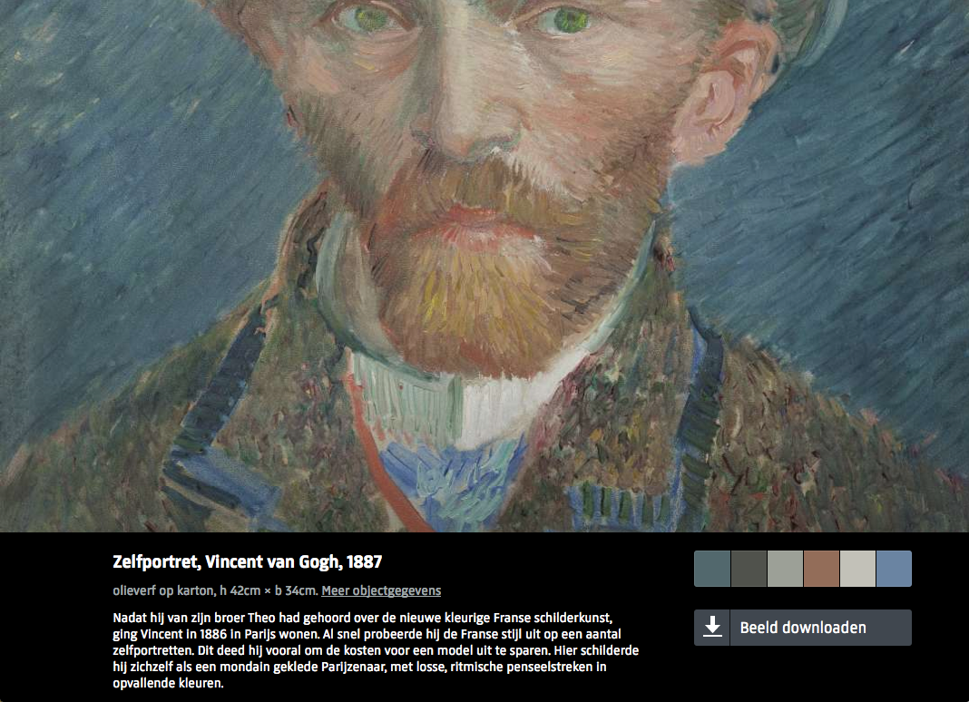
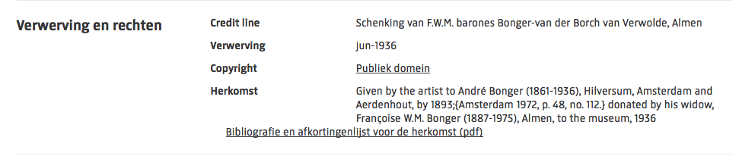

Notes:
They released 150,000 high resolution images as large as 200MB into the public domain using CC0. They abided by the principle of unrestricted access to the digital public domain – as in the U.S., faithful digital reproductions of PD works are considered PD in Europe.*
…………………………………………………………………………………………………………………………………………………………………………………………………….
*In Australia this issue has yet to be considered. At its heart is the question as to what constitutes originality for the purpose of copyright.
See http://www.artslaw.com.au/articles/entry/photo-reproduction-of-artworks/

Slide 23
Brooklyn Museum
100k+ online image collection
CC BY for images and text owned by museum; PD for PD works
Most restrictive → most open
2004: CC BY-NC-ND
2010: CC BY-NC
Today: CC BY & PD statement
Notes:
This is a story about increased comfort with open licensing of collection…
The Brooklyn Museum has a very interesting story behind its use of CC. BM’s mission has always been about growing community and visitor experience, so in 2004 they wanted to extend that to their online presence. They decided to CC license
to images and text they owned on their website to encourage user engagement; and,
To images collection of public domain works.
Initially they opted to use CC BY-NC-ND the most restrictive CC license. They had a great experience, so
in 2010, they decided to allow derivatives by moving to CC BY-NC. Having a further great experience,
they moved to the most open license, CC BY.
And where the object contained in the image is in the public domain, they have identified that the image itself is also under “no known copyright restrictions” – in line with their contributions to Flickr Commons.

Slide 24
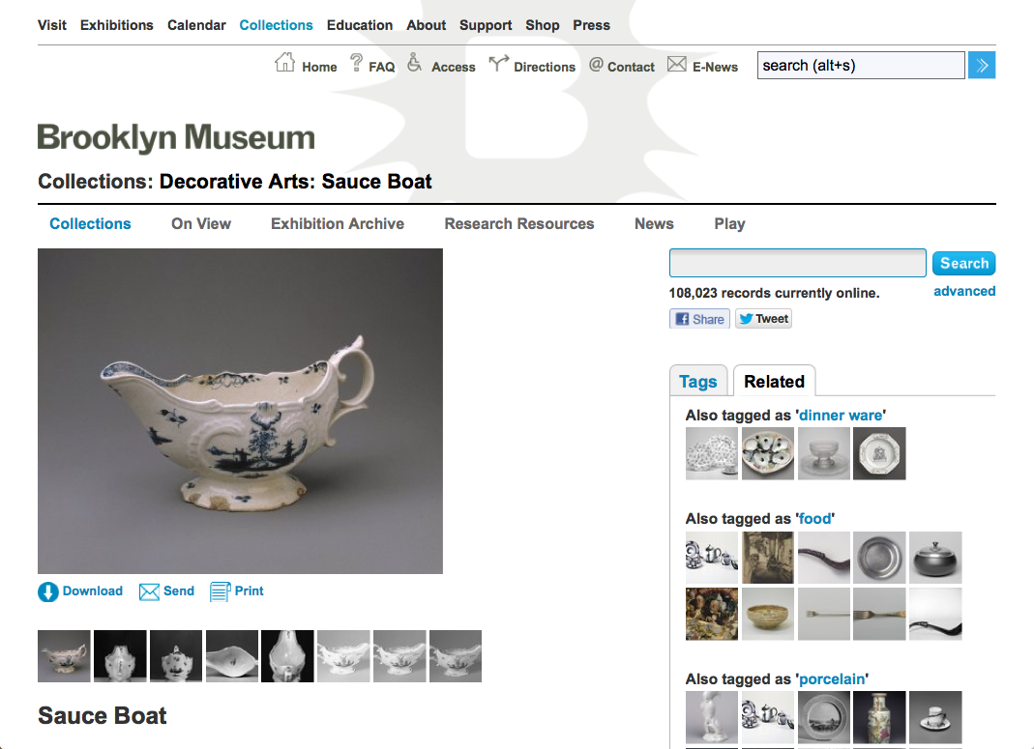
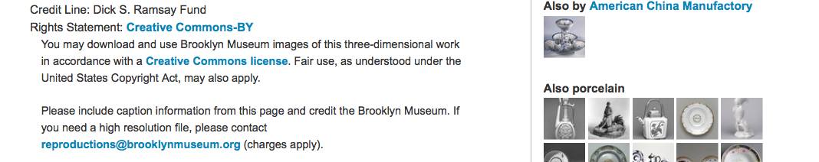

Notes:
Both Rijksmuseum and Brooklyn are examples how to leverage open licensed digital collections
as a promotional tool to extend the museum’s reach beyond its own website to other platforms e.g. Wikipedia
To educate public about its collection via true color images, accurate metadata
They wanted the public to engage with more than what they had on display,
A quality control and validation mechanism- downloadable high quality images
Best practice collection records include
a very clear rights statements that notes that the image is governed by a CC BY license linked to the license deed.
attribution guidelines

Slide 25
New York Public Library
20,000 cartographic works released as high resolution downloads via CC0
CC0 for digital reproductions b/c maps are in the public domain
“We believe our collections inspire all kinds of creativity, innovation and discovery."
Notes:
This is a great example of moving from a digital collection into creative re-use…
In 2005 NPL launched a site called public gallery which contained 275,000 images for its collections. Quoting the NYPL-
“Over time, however, we reconsidered the purpose of a site showcasing digitized materials to aid in research and spur creative reuse, and we increasingly felt that the concept of a passive "gallery" was insufficient to encompass all that we wanted to accomplish.”
In 2013, they launched their Digital Collections site http://digitalcollections.nypl.org/about

Slide 26
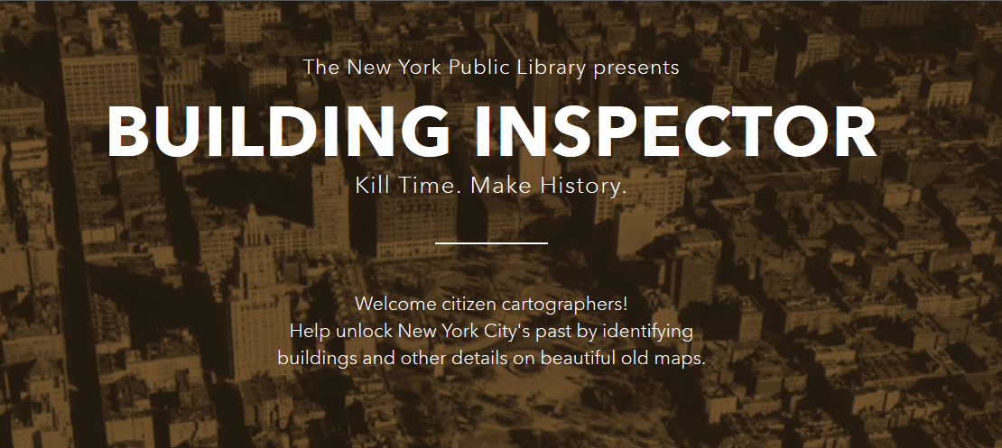
“By participating in this project, you agree that any copyrightable content you submit shall be subject to a Creative Commons CC0 1.0 Universal Public Domain Dedication”
Notes:
This is a great example of user engagement- engaging and enlisting the public to assist in the project-
This app is the latest in a series of public-facing tools which are used to create new works for the digital collection-
“We're training computers to do the heavy lifting, and then distributing the remaining quality control tasks to smart, motivated citizens. The goal? To produce a comprehensive directory of old New York (or, as we like to think of it, a time machine). With that information organized and searchable, we can ask new kinds of questions about history. It will allow our interfaces to drop pins accurately on digital maps when you search for a forgotten place. It will allow you to explore a city's past on foot with your mobile device, 'checking in' to ghostly establishments (Empire State Building, meet Waldorf-Astoria Hotel). And it will allow us to link other historical documents to those places: archival records, old newspapers, business directories, photographs, restaurant menus, theater playbills etc., opening up new ways to research, learn, and discover the past.”
By participating in this project, you agree that any copyrightable content you submit shall be subject to a Creative Commons CC0 1.0 Universal Public Domain Dedication

Slide 27
Powerhouse Museum
1st museum in the world to share images on Flickr Commons
Educational resources licensed to ensure free re-use
Notes:
Powerhouse Museum approach displays the same aspiration to make collections open through licensing…
1st museum in the world to share images on Flickr Commons- ‘Photo of the Day’ via Flickr- “it allows photographers and other creators to choose different licensing options.”
a suite of digital educational materials for children under the banner of ‘Play’- designed to enhance an actual visit to the museum- “Creative Commons also provides a means for us to encourage the use of these in schools without teachers needing to be fearful of paying CAL fees for their use”
The museum uses a mix of rights to collection- full copyright, ‘no known copyright,’ and CC BY-NC-ND licence

Slide 28
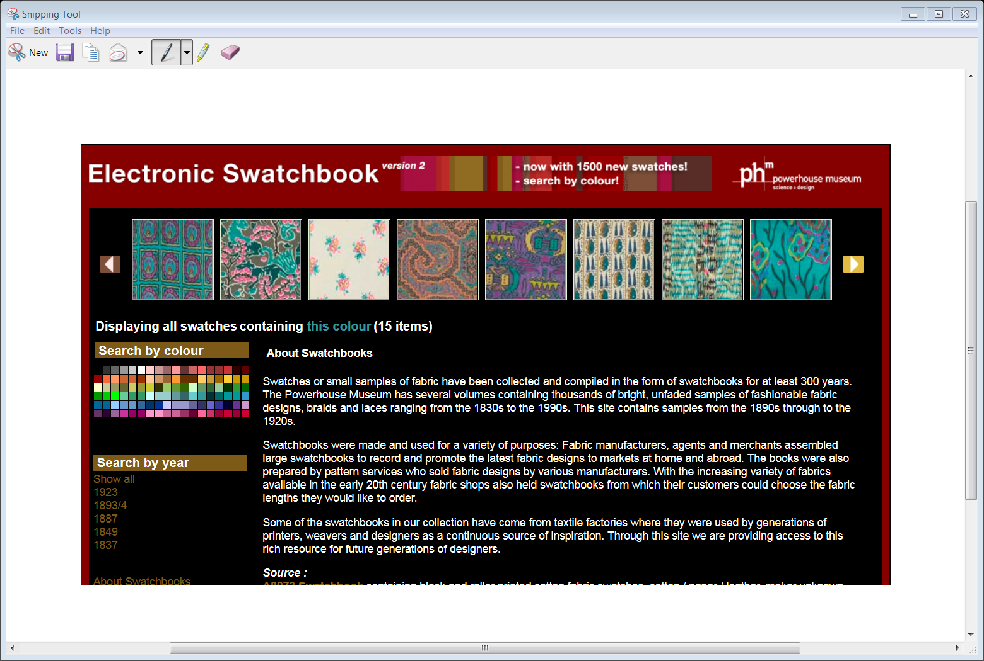
Reprogramming The Museum by Luke Dearnley, Powerhouse Museum
Notes:
A visually stunning App ‘Electronic Swatchbook’-
Swatchbooks, digitised from the museums collections of fabric designs, braids and laces from 1830s to 1920. Clear rights statement “All in the public domain (in Australia)”
"Through this site we are providing access to this rich resource for future generations of designers“
Powered by sophisticated, purpose built Search interface-
Actively encourages engagement and participation- tagging of resources
Refer to : Dearnley article “It provides details on the lessons learned and suggests best practices for API development in the cultural sector.”

Slide 29

History SA
AusGOAL
Notes:
History SA is a case study for using the AusGOAL (Australian Governments Open Access & licensing) framework to implement open access to digital collections…
[say something about AusGOAL? - have asked Baden]

Slide 30
Engaging
Users +
Community
Sharing
Digital
Collections
Sharing
Collection
Records
Notes:
These are just a few illustrative and inspiring examples of using CC to open up digital collections. Sharing digital collections and collection records naturally leads to engaging and growing users, in addition to bringing wider exposure to collections.

Slide 31
Promotional & educational tool
Increases reach + impact of collection
Goodwill w/public, creative industries
Enable unexpected, creative & delightful results
Notes:
Benefits of open licenced digital collections
Promotional & educational tool
Increases reach + impact of collection
Goodwill w/public, creative industries
Enable unexpected, creative & delightful results
Lead to refocusing of resources, new funding + revenue models

Slide 32
Resources
Warwick Cathro. 2007 .“Federated discovery opportunities for Australia’s collecting institutions” https://www.nla.gov.au/openpublish/index.php/nlasp/article/viewFile/1035/1303
Mansfield, T., Winter, C., Griffith, C., Dockerty, A., Brown, T. 2014. “An Innovation Study: Challenges and Opportunities for Australia’s Galleries, Libraries, Archives and Museums”. http://museumsaustralia.org.au/userfiles/file/GLAM_Innovation_Study_September2014-Report_Final_accessible.pdf
The Open Data Handbook http://opendatahandbook.org/en/
Australian Government Open Access Framework (AusGOAL) http://www.ausgoal.gov.au
Notes:
These are useful reading and relevant assistance for open licensing

Slide 33
This work, “Creative Commons & Digital Collections ", is a derivative of "Creative Commons and cultural heritage" by Jane Park used under CC BY. " Creative Commons & Digital Collections " is licensed under CC BY by Nerida Quatermass.
Except where otherwise noted:
CC BY creativecommons.org/licenses/by/4.0

